Slide 1
BIOLOGY PRACTICAL 553/3
BY TR. SSEMATIMBA GODFREY 0756341741

Slide 2
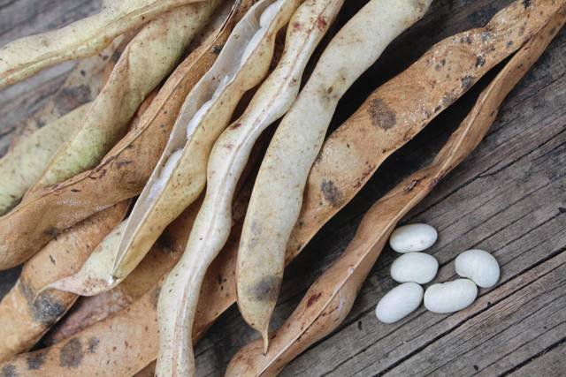
MATURE BEAN POD
SPECIMEN W

Slide 3
IDENTITY
Legume
Reason : Fruit wall has two lines of weakness/ 2 sutures
Its pericarp is dry with 2 longitudinal sutures (lines of weakness) , tapering at both ends’
Its epicarp/ surface is rough and bumpy
PLACENTATION;
Marginal placentation
Reason: Seeds are attached along one margin of the fruit wall
Seeds: large , many in one locule.
Dispersal : Self dispersal/ self-explosive mechanism
Adaptation for dispersal ; Has lines of weakness/sutures; split open to release seeds
Description of mode of dispersal : When dry, the fruit breaks along to longitudinal sutures , releases the seeds to the ground.

Slide 4
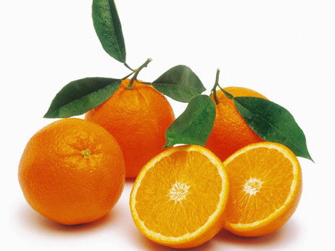
MATURE ORANGE FRUIT
SPECIMEN Z

Slide 5
IDENTITY; BERRY
Reason; (i) Entire pericarp is fleshy, (ii) presence of many seeds
Pericarp; partly fleshy , 3 layered ; epicarp is thick , tough, leathery , has numerous oil glands in pits, pigmented
Mesocarp is fleshy
Endocarp is soft
Description of placentation ; Axile placenta
Description of placentation ; Seeds radiate outwards from the center of the fruit on placenta formed from joined septa.
Seeds ; many , one end is pointed.
Locules ; many, densely packed with fluid-filled vesicles / succulent .

Slide 6
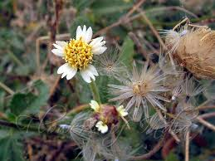
TRIDAX FRUIT
SPECIMEN Y

Slide 7
IDENTITY; CYPSELA
REASON ; Dry persistent calyx (pappus)
Pericarp ; Dry , has rough surface , hairy , bears a pappus (persistent calyx)
Type of placenta : Axile placenta.
Seeds: 1 locule, containing one seed
Dispersal : Wind dispersal
Adaptation for dispersal : Has pappus; that can easily float in the air to be carried away by wind . It is also light and small; so can easily be blown by wind.
Describe how the specimen is dispersed : Being light and small, when dry, the fruit is blown by wind from the parent plant to another place.

Slide 8
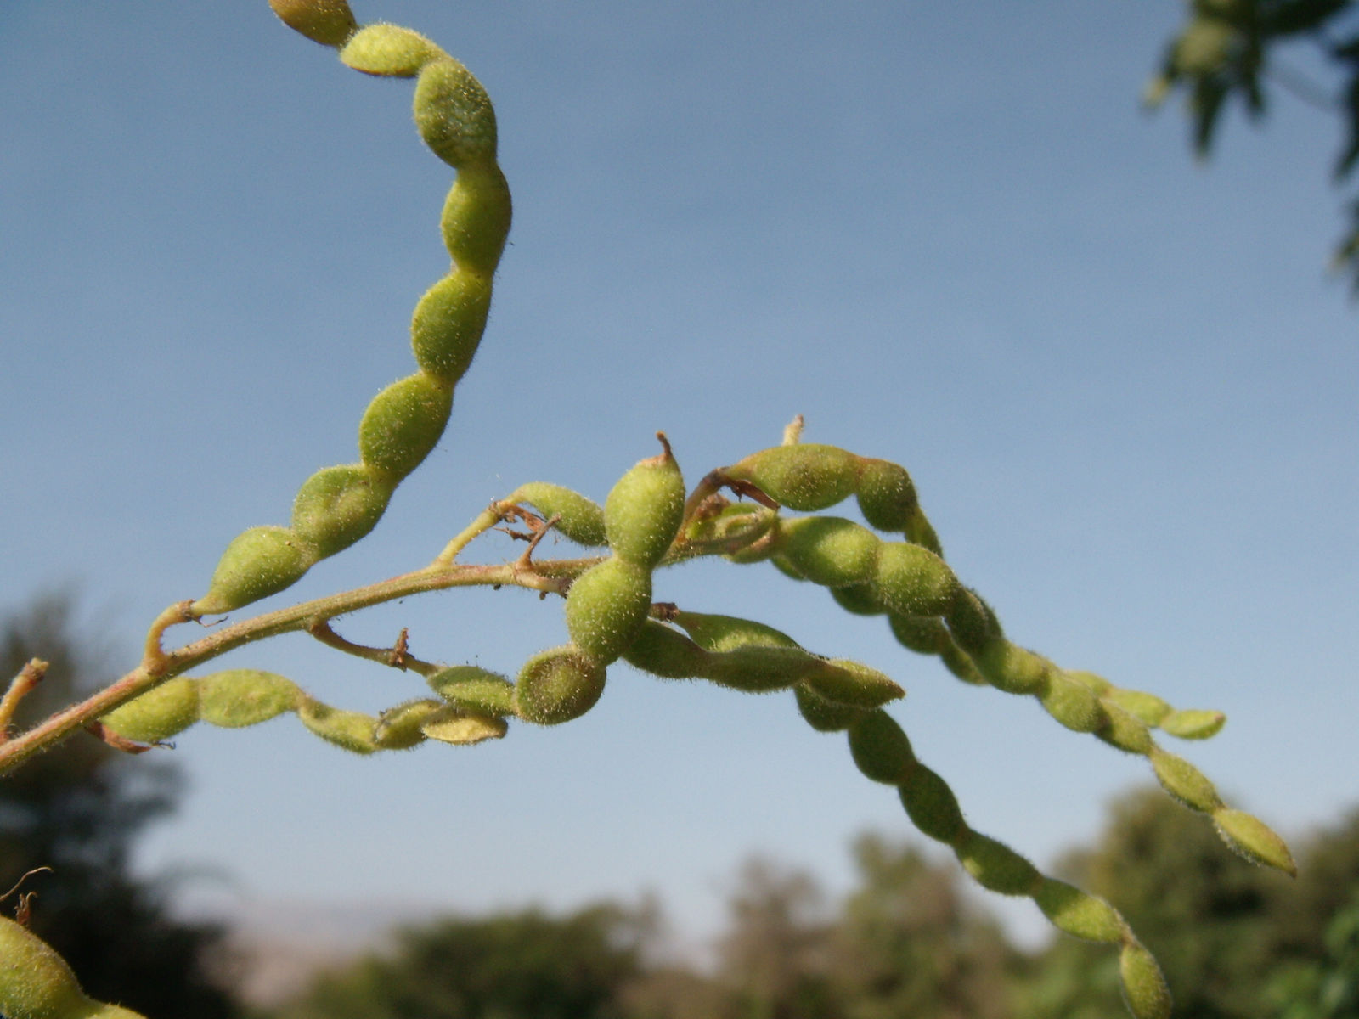
DESMODIUMFRUIT
SPECIMEN X

Slide 9
IDENTITY; Schizocarp / lomentum
Reason for identity ; Has several one seeded parts/loments/segments.
Pericarp; DRY , Has many transverse sutures ( lines of weakness), surface is rough , hairy, sticky
Type of placenta ; Marginal placenta
Description of placentation : Seeds are attached along one margin of the fruit wall.
Seeds ; Large , many ; one per locule.
Locules; Many ; each enclosing one seed.
Dispersal ; Self dispersal / self-explosive mechanism
Describe how the specimen is dispersed ; When dry, the fruit breaks along two longitudinal sutures; releases the seeds to the ground.

Slide 10
SAMPLE SCENARIO
Mpanga and Lutaaya are renown farmers who grow crops of specimens w and z respectively. They are however challenged with birds that come to their gardens and eat their crops and then fly away. Surprisingly , Mpanga found a plant in his garden with specimens Y and Z which he had never planted.
Task
Examine specimens W and Z and state the agent of dispersal for each. How is each specimen adapted being dispersed by the agent stated? Describe how specimen Z could have reached Mr.Mpanga’s garden. Make a well labelled drawing of the transverse section of specimen Z.

Slide 11
N.B;
well labelled diagrams should be drawn including the magnification
Adaptation for each mode of dispersal for each specimen for be given

Slide 12
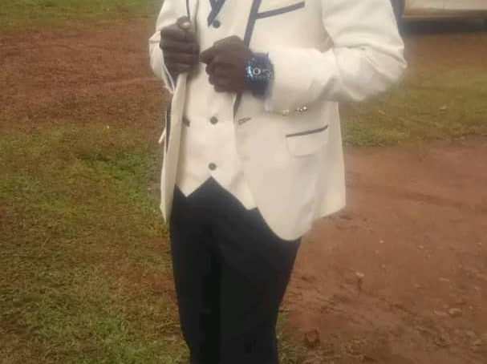
END
THANK YOU.

